Slide 1



Project Title: Library Management System
Presented By: M. Usama , Fizza Asghar

Slide 2
The Islamia University of Bahawalpur
Rahim Yar Khan Campus
Department Of Computer Science & IT
Project Title
Library Management System
Project Title: Library Management System
Presented By: M. Usama , Fizza Asghar

Slide 3
Presented by:
Muhammad Usama
Fizza Asghar
Supervised by:
Mirza Adnan Baig
Project Title: Library Management System
Presented By: M. Usama , Fizza Asghar

Slide 4
OUTLINE
Introduction
Motivation
Methodology
Database Design
Conclusion
Future Work
References
Screenshots
Project Title: Library Management System
Presented By: M. Usama , Fizza Asghar

Slide 5
Introduction
Library management is a project that manages and stores books information electronically according to student’s needs. The system helps both students and library manager to keep a constant track of all the books available in the library.
This Web-Based Application Flash Manager (Library Management System LMS) will contain admin login page in which admin can control the whole site and provide services to the users of the website.
Project Title: Library Management System
Presented By: M. Usama , Fizza Asghar

Slide 6
Motivation
A library management system should enhance the efficiency of both the librarians and the library users. It also enables librarians to easily catalog books and keep proper records of students, books info, books issued, books reissued, and the books those not returned. So that was our motivation while creating this project.
Also this project can be used by any education institute for providing information about author, publishers and the available books.
Project Title: Library Management System
Presented By: M. Usama , Fizza Asghar

Slide 7
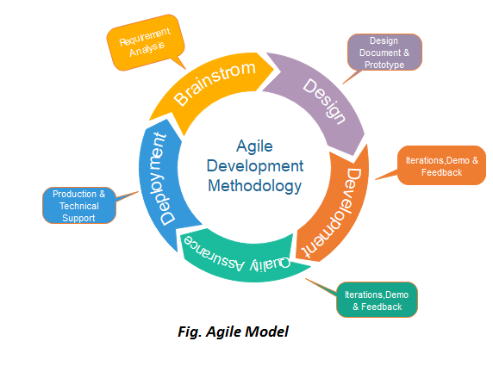
Methodology
This paradigm was selected due to the reason that we have a small team. We are to deliver the work products to satisfy the user. Our team is having constant communication with the stakeholders which include our particular approach into the category of agile development.
There are following elements of the Agile Model;
Requirement Analysis
Design Document & Prototype
Iterations, Demo & Feedback
Production and Technical Support
Project Title: Library Management System
Presented By: M. Usama , Fizza Asghar

Slide 8
Database Design
Tables:
SQL Command (select, update, insert, delete):
Books
Book_ issue
Admin
Categories
Publishers
Authors
Students
Creating table “Books”: Inserting Some Data in “Books”
Creating table “Book_issue”: Inserting Some Data in “Book_issue”
Project Title: Library Management System
Presented By: M. Usama , Fizza Asghar

Slide 9
Database Design (ERD)
Book author
Book name
Book description
Book id
Email
Book
Password
Name
Maintains
Borrows
Admin
Student
Student RollNo
Student class
Student name
Student contact
Project Title: Library Management System
Presented By: M. Usama , Fizza Asghar

Slide 10
Conclusion
The project being developed is focused on the aim that common book readers are benefited the most. And this project will be capable of being easily deployed in real time environment. It will work as a real world application.
This application will be a bright example of the fact that how can technology affect the daily life and bring about the improved betterment of currently available facilities.
Project Title: Library Management System
Presented By: M. Usama , Fizza Asghar

Slide 11
Future Work
They are used in public and private libraries as well. The rise in demand for library management software is projected to increase the sales growth of the global Library Management Software market in the forecast period, set between 2021 and 2031.
Project Title: Library Management System
Presented By: M. Usama , Fizza Asghar

Slide 12
References
www.google.com
www.w3resource.com
www.stackoverflow.com
www.guru99.com
docs.microsoft.com
Project Title: Library Management System
Presented By: M. Usama , Fizza Asghar

Slide 13
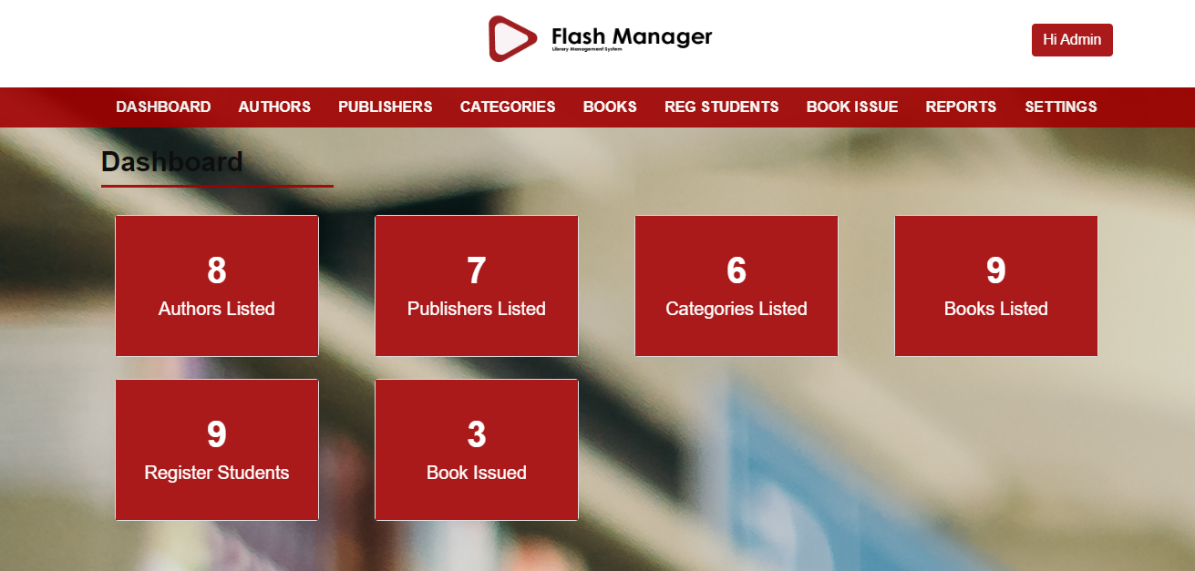
Admin Dashboard
Project Title: Library Management System
Presented By: M. Usama , Fizza Asghar

Slide 14
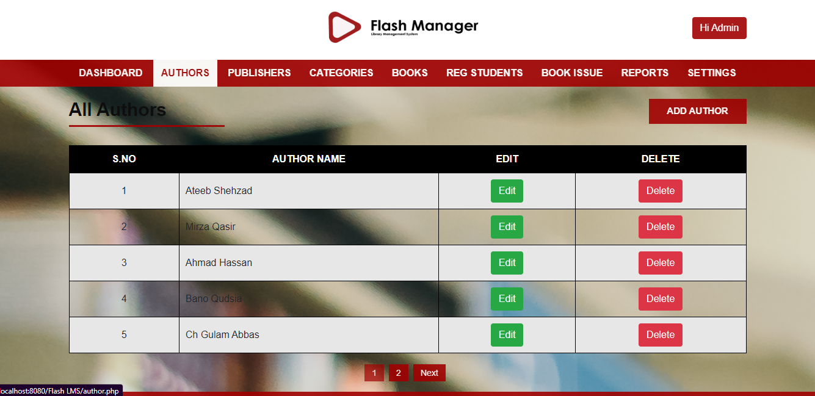
Authors
Project Title: Library Management System
Presented By: M. Usama , Fizza Asghar

Slide 15
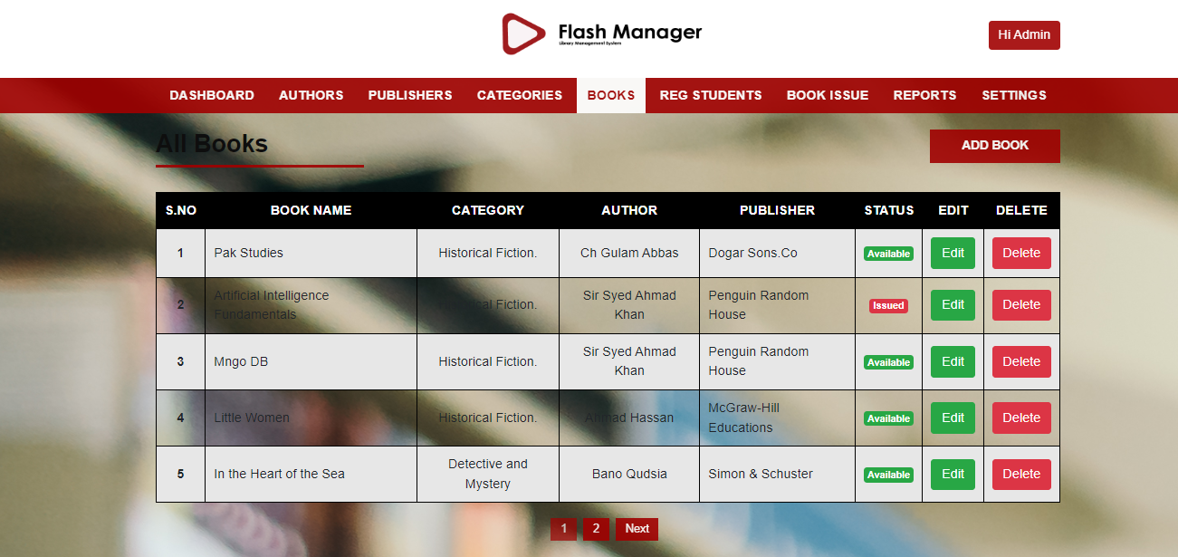
Books
Project Title: Library Management System
Presented By: M. Usama , Fizza Asghar

Slide 16
THANK YOU
Project Title: Library Management System
Presented By: M. Usama , Fizza Asghar

